Slide 1


Predicting Song Popularity with Deep Learning
A Data-Driven Approach for Streaming Platforms
DECISION 546Q Final Project
Team 45: Sam MacArthur, Ziling Chen, Chris Chen, Neha Masqsood, Krishna Gupta

Slide 2

The Problem
Streaming platforms have become the central channel for music consumption
Predicting song popularity is essential to prevent churn and maintain market share
Deep learning cannot predict with certainty, but provides actionable estimates
DECISION 520: Team-45

Slide 3
Dataset
15,000 songs
13 audio features: song_name, song_popularity, song_duration_ms, acousticness, danceability, energy, instrumentalness, key, liveness, loudness, audio_mode, speechiness, tempo, time_signature, audio_valence
Problems we met:
Heavily imbalanced data
Overfitting model
Solution：
a multilayer perceptron (MLP) neural network with a wider, shallower architecture, and approximately 137,000 trainable parameters
DECISION 520: Team-45

Slide 4
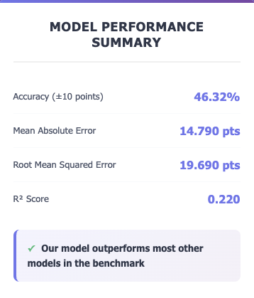
Model Details: MLP
Architecture: 3-layer feedforward neural network (384 → 192 →96 →1)
Key Modifications:
Stratified sampling to handle severe class imbalance in the popularity distribution
CosineAnnealingWarmRestarts scheduler
Xavier initialization, BatchNorm, and Dropout for tuned training
Layer Details:
Input Layer: 13 features derived from audio attributes such as energy, loudness, tempo, and valence.
Hidden Layer 1: 384 neurons → Batch Normalization → ReLU → Dropout (p=0.15)
Hidden Layer 2: 192 neurons → Batch Normalization → ReLU → Dropout (p=0.15)
Hidden Layer 3: 96 neurons → Batch Normalization → ReLU → Dropout (p=0.10)
Output Layer: 1 neuron (linear activation as a single popularity score)
DECISION 520: Team-45

Slide 5
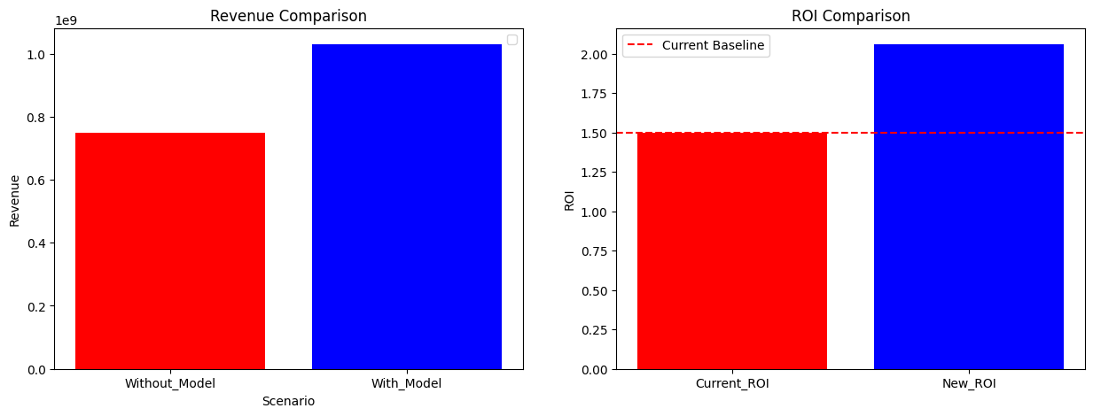
Business Application
Opportunity:
Streaming platforms spend $500M+ annually promoting new releases.
Budgets are often spread evenly, leading to wasted marketing spend.
Solution:
Our model predicts high-potential songs before release using audio features.
Platforms can allocate 70% of marketing budget to the most promising tracks.
Impact:
Baseline Revenue (no model): $750M
New Revenue (with model): $1.03B
Additional Revenue: +$280M
ROI Improvement: from 1.5× → 2.06× per $1 spent
DECISION 520: Team-45

